Slide 1
Dr.Diabetes
Developed by
Dr. Safaa Zaman - Non-Technical
Mr. Sayed Mohammad Al-Hashemi – Designer
Mr. Essa Ibrahim - Developer
Mr. Mshary AlSharekh - Developer
2015

Slide 2
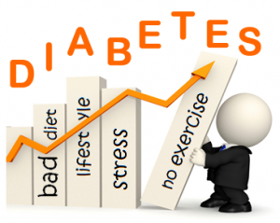
Outline
Problems and Solutions
Validation
Execution & Design
Business Model Canvas
Potential Growth

Slide 3
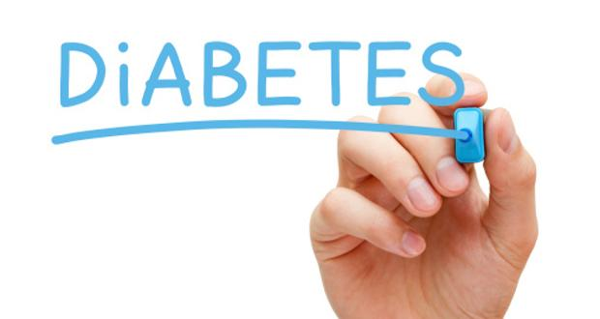
Problems & Solution
Problems
Acclimatization to the disease.
Difficulties reaching the diabetics.
Solutions
Helping diabetics make diabetes easier to deal with.
Making a hub for a diabetes community.

Slide 4

Validation
Kuwait is the sixth worldwide in the prevalence of diabetes (Kuwait News Agency (KUNA), 2010).
180,000 ~ 14.6 % Kuwaiti
360,000 ~ 14.6 % Non-Kuwaiti
= 29.2 % (in Total)
The Diabetes represents 37% of the leading causes of death (International Diabetes Federation (IDF))
In Kuwait, there are more 50 diabetes clinics.

Slide 5
Validation
Dasman Diabetes Institute will sponsor the product.
An API will be provided to access their database.
They will market the product to the patients signing up.

Slide 6

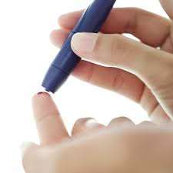
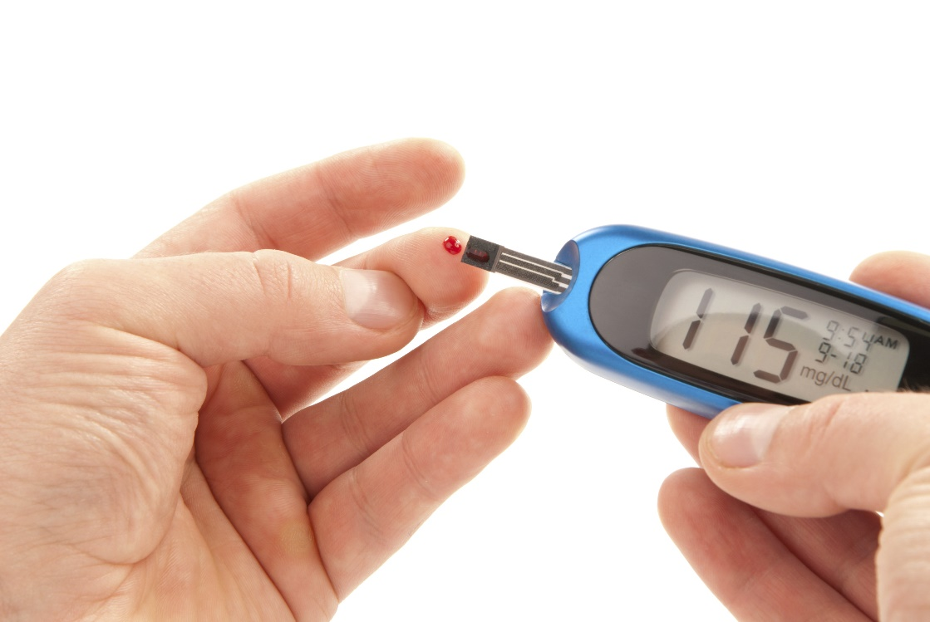
Key Activity
Enter Your Blood Sugar Reading:
Before or after meals :
Reset
Save

Slide 7




Key Activity
Very Low
Very High
High
Low
Normal

Slide 8
Minimum Viable product
Sugar blood test
Request Appointment
Ask Doctor
Logbook

Slide 9


Value Propositions
Clinics
Diabetics

Slide 10
Value Propositions
More fluid communication between the diabetic and the clinic.
Improves the clinic’s credibility.
Good advertising for their target audience.
Cost effective patient management (reduces number of employees) with forward thinking.

Slide 11
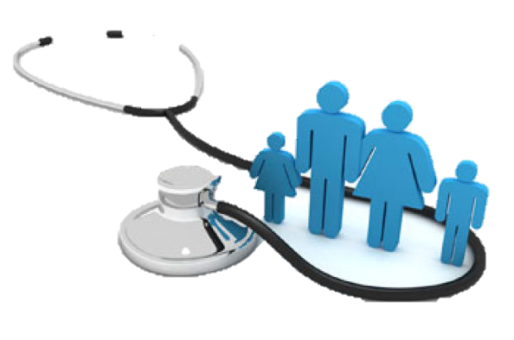
Value Propositions
Independent patient.
Self awareness.
Real time indication of his condition.

Slide 12
Customer Relationships
Email
SMS
Application
Push Notification

Slide 13
Cost Structure
Hosting (~ 100$ per year)
Apple Developer Account (99$ per year)
Android Developer Account (21$ per year)
Payment gateway (first aid = 1200$ + 60$ per year)
SSL Certificate (300$ per year)
SMS system (~ 3000$ for 100,000 sms)

Slide 14
Revenue Streams
Government Sponsor (sponsorship)
Dasman Diabetes Institute (sponsorship)
Clinic (Annual subscription fee based on number of patients)

Slide 15
Potential Growth
Add sound system for old people and special needs.
Enable fingerprint login.
Paid online consultations.
Giving patients greater choice when choosing a doctor.
More transparency.
Including research papers in the information section.
Including more specialties to create an e-Hospital

Slide 16
Thank you

